Slide 1
Docker
Notes:
how many familiar with docker?
Frankly I don't know much no one will shut up
1.3 bil

Slide 2
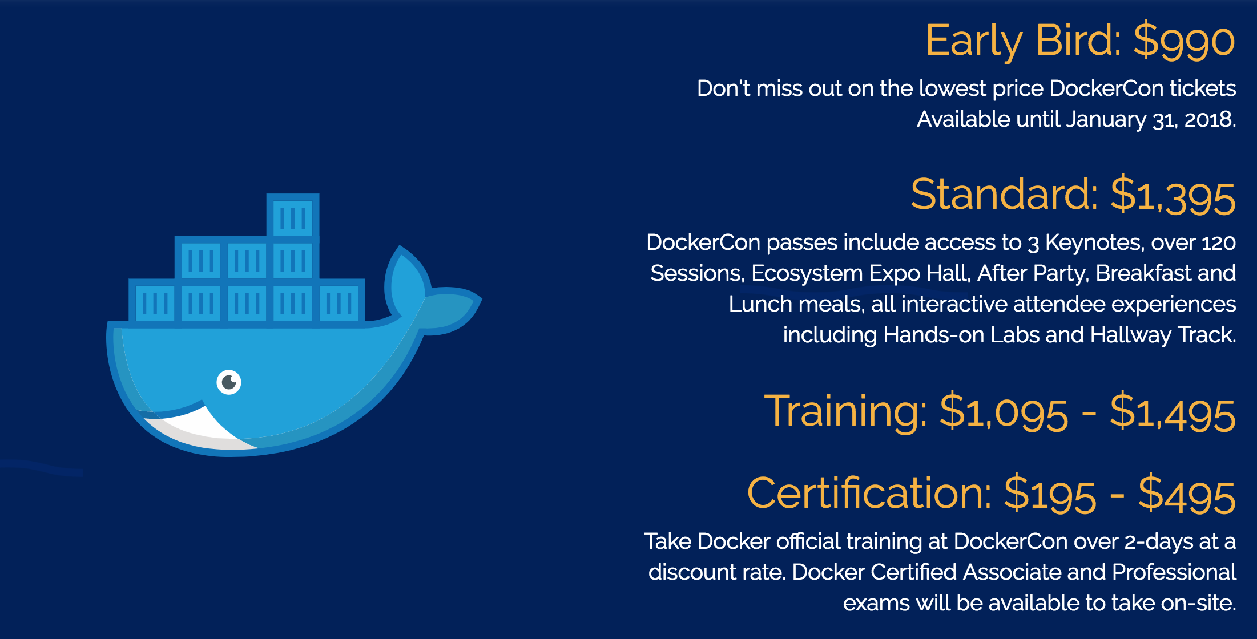


Slide 3
What is the problem?
Notes:
Someone builds code...

Slide 4
Notes:
Chaos ensues

Slide 5
Why does it happen
Operating systems
Software
File Dependencies
Installation tools

Slide 6
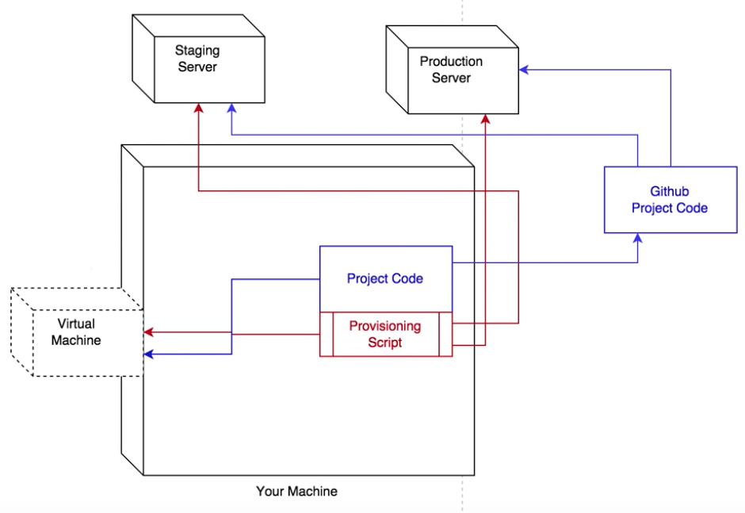
Solving with virtual machines

Slide 7
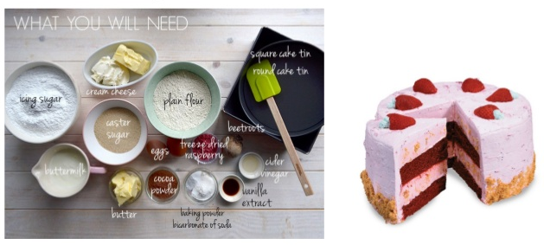
Solving with virtual machines
Notes:
Traditionally…

Slide 8
Notes:
At least if you’re not well versed, much like handing instructions to an inexperienced chef

Slide 9
What is docker
No setup or installation
Docker Engine
Can sit on a very bare bone server

Slide 10
Virtual machines vs Docker
Notes:
4-6X!
If tuned properly, can have 4-6x more applications running

Slide 11
What is docker
No setup or installation
Docker Engine
Can sit on a very bare bone server
Self contained
Images can be uploaded and cloned to replicate the exact same app.
Dockerhub
Notes:
Doesn’t matter what version of python you have installed already.

Slide 12
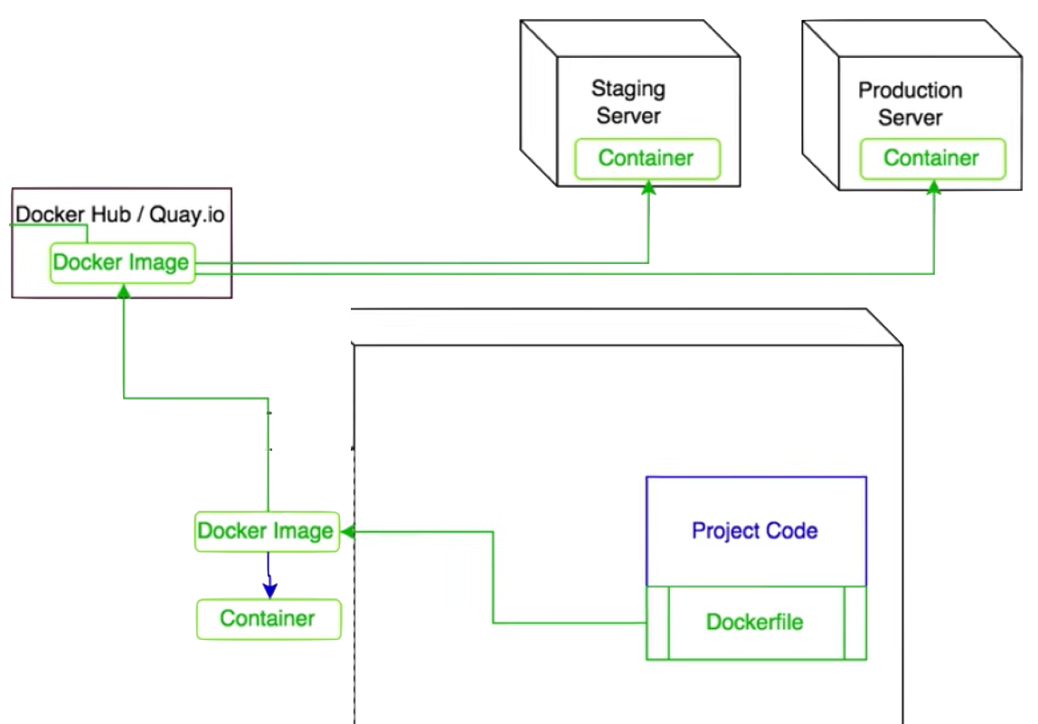
What is docker

Slide 13
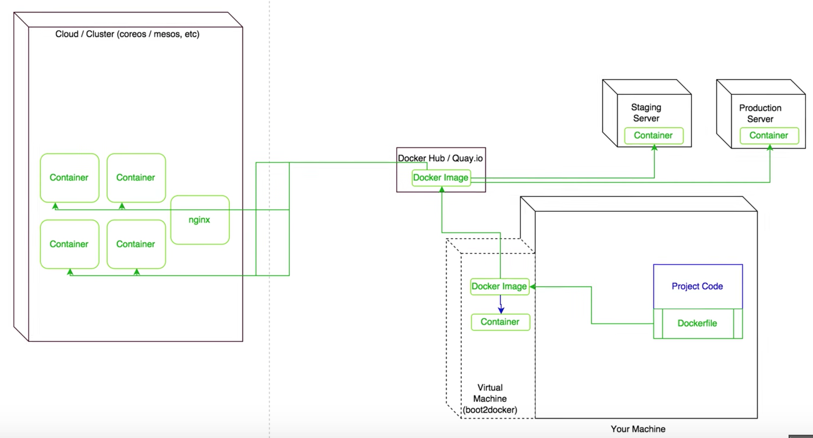
What is docker

Slide 14
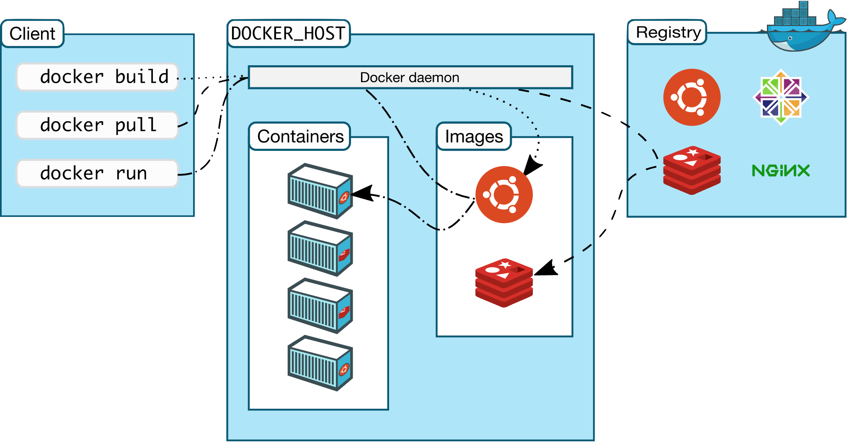

Slide 15
Why is this relevant to ML
Streamline Development Workflows (like github)
Microservices – API that runs algorithms in real time (such as Sentiment analysis)
Reproducible Data Science
Running on cloud servers
Notes:
Share and build on top of other apps/environments
you’ll include further dependencies for building back end server. (closes environment so conflicts don’t occur when run on same server)

